Slide 1
Jordan Berg – Technology Assessment Specialist – National Telehealth Technology Assessment Center Doris Barta – Director – National Telehealth Technology Assessment Center
Telehealth Technology Post COVID-19
It’s More Than Just a Smartphone

Slide 2
Housekeeping
You will be muted upon entry.
Please keep your video off to maintain a strong connection.
To avoid audio issues, please choose either computer audio OR phone audio; using both may result in an echo on the line.
For optimal viewing, we recommend using Side-by-Side Mode. To activate Side-by-Side, click on View Options at the top center of your screen and choose Side-by-Side Mode from the dropdown.
Use chat freely to submit all questions and comments and we will answer as many questions as possible at the end of the presentation.
Notes:
Sarah

Slide 3
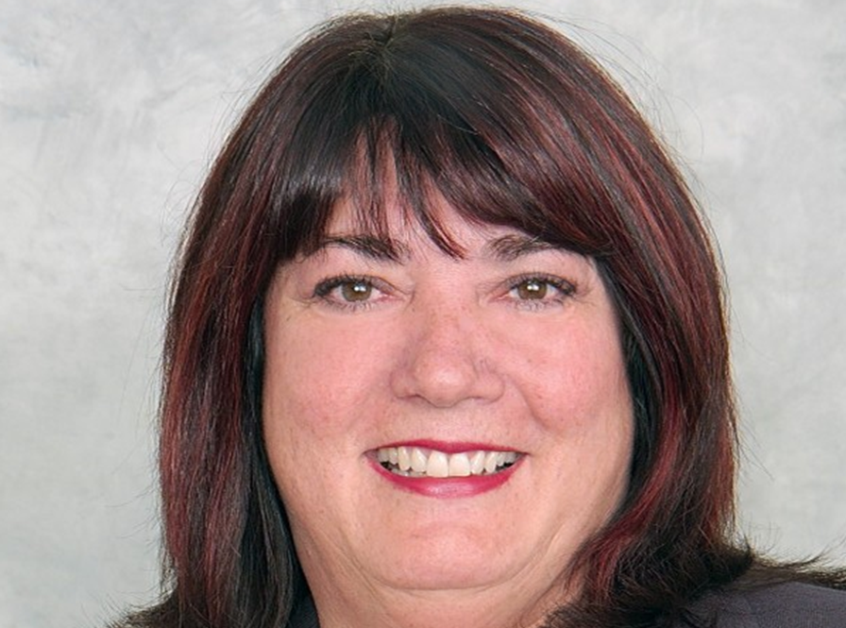
Todays Speakers
Doris T. Barta is the Director of the National Telehealth Technology Assessment Center (TTAC), one of two National Telehealth Resource Centers. Ms. Barta has worked in the telehealth field since 1992, serving in the capacity of a telehealth network director as well as in the role of fund development for telehealth. Ms. Barta also served as the Principal Investigator for the Northwest Telehealth Resource Center for 10 years.
Jordan Berg is the Technology Assessment Specialist at National Telehealth Technology Assessment Center (TTAC). Jordan has over thirteen years of hands-on experience working with the Alaska Tribal Health System in both administrative and technical roles with ten of those years working in telemedicine.
Notes:
Sarah

Slide 4
Topics Discussed Today
Review of the Project
Current Federal Waivers
Overview of TTAC
TTAC Presentation – Trends, Hardware, and more
Live Demonstration
Final Thoughts
Q & A
Notes:
Katy

Slide 5
Introduction to the Project
In early 2021, the New York State School-Based Health Association was awarded a grant from the Mother Cabrini Health Foundation to increase & improve the use of telehealth in school-based health centers around the state.
Multiple health systems were contacted and surveyed, with 10 health systems signing onto the project, which will run through the end of 2021.
Notes:
Katy

Slide 6
Project Components
Up to 10 hours of individualized technical assistance to each sponsoring organization (SO).
Kickoff stipend to fund improvement efforts.
3 didactic webinars, with peer sharing.
Additional peer sharing via remote and/or face-to-face meetings.
Sessions at NYSBHA Annual Conference.
Reporting on quantifiable outcomes.
NYSBHF has applied for funds to continue & expand the project in 2021.
10 additional Sponsoring Organizations
Ongoing support of initial 10 Sponsoring Organizations
Notes:
Lisa

Slide 7
Before We Get Started…
“The implementation of a telehealth technology, requires a team approach. Team members will need to address issues that are equal parts clinical, technical, operational, and systems related. From the very beginning of the technology selection process, it is important to include the insight and viewpoints of a variety of stakeholders. Many of the required areas of expertise may already exist within an organization, with clinicians, administrators, case managers, technology, and networking staff able to provide input.”
- Telehealth Technology Assessment Resource Center
Source: https://telehealthtechnology.org/toolkit/technology-assessment-101-process-overview/
Notes:
Katy
Often, instead of conducting a thorough technology assessment, organizations simply select a device by asking their providers to choose the devices that they feel might meet their needs, or by asking IT staff to choose the equipment which they are able and willing to support.

Slide 8
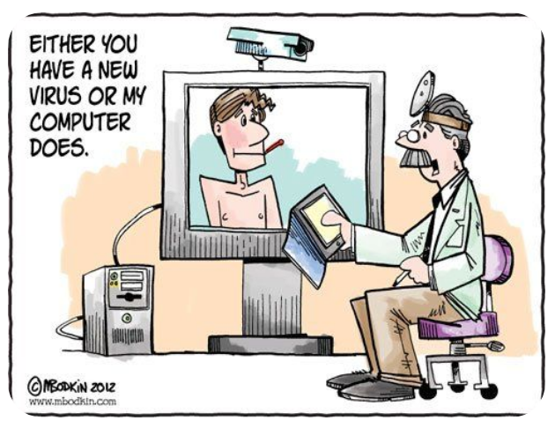
Current Federal Waivers - Technology
A covered health care provider that wants to use audio or video communication technology to provide telehealth to patients during the COVID-19 nationwide public health emergency can use any non-public facing remote communication product that is available to communicate with patients.
The Office for Civil Rights (OCR) is exercising its enforcement discretion to not impose penalties for noncompliance with the HIPAA Rules in connection with the good faith provision of telehealth using such non-public facing audio or video communication products during the COVID-19 nationwide public health emergency.
Notes:
Katy
This exercise of discretion applies to telehealth provided for any reason, regardless of whether the telehealth service is related to the diagnosis and treatment of health conditions related to COVID-19.
For example, a covered health care provider in the exercise of their professional judgement may request to examine a patient exhibiting COVID- 19 symptoms, using a video chat application connecting the provider’s or patient’s phone or desktop computer in order to assess a greater number of patients while limiting the risk of infection of other persons who would be exposed from an in-person consultation.
Under this Notice, covered health care providers may use popular applications that allow for video chats, including Apple FaceTime, Facebook Messenger video chat, Google Hangouts video, Zoom, or Skype, to provide telehealth without risk that OCR might seek to impose a penalty for noncompliance with the HIPAA Rules related to the good faith provision of telehealth during the COVID-19 nationwide public health emergency.
Providers are encouraged to notify patients that these third-party applications potentially introduce privacy risks, and providers should enable all available encryption and privacy modes when using such applications.
Under this Notice, however, Facebook Live, Twitch, TikTok, and similar video communication applications are public facing, and should not be used in the provision of telehealth by covered health care providers.
Covered health care providers that seek additional privacy protections for telehealth while using video communication products should provide such services through technology vendors that are HIPAA compliant and will enter into HIPAA business associate agreements (BAAs) in connection with the provision of their video communication products. The list below includes some vendors that represent that they provide HIPAA-compliant video communication products and that they will enter into a HIPAA BAA.
Skype for Business / Microsoft Teams
Updox
VSee
Zoom for Healthcare
Doxy.me
Google G Suite Hangouts Meet
Cisco Webex Meetings / Webex Teams
Amazon Chime
GoToMeeting
Spruce Health Care Messenger

Slide 9
Additional Resources
National Telehealth Technology Assessment Resource Center Toolkits
McKinsey & Company: Telehealth – A Quarter Trillion Dollar Post COVID-19 Reality?
Care Innovations – What is mHealth and How is it Different from Telehealth?
Notes:
Katy

Slide 10
Questions?
Thanks for listening!
katy@adkhealthsolutions.com| 518-586-6247
Notes:
Katy
Thank you for joining us today – we will now take time to answer some questions!

