Slide 1

A Year of Behavioral Health Innovations:
Reports from the Field
NYSBHA Annual Conference
March 17, 2023
Notes:
Shout out to our Project Manager Lisa Perry and Ronda Kotelchuck, Board Chair of the NY SCHOOL BASED HEALTH FOUNDATION, Their unwavering support in this project.

Slide 2

Our Agenda
Welcome
Program Background & Findings
Panelists’ Reports from the Field
Q & A

Slide 3



Our Panelists
April Lee, MD, Director, Division of Adolescent Medicine, Department of Pediatrics, Staten Island University Hospital/ Northwell Health
Suanne Kowal-Connelly, MD FAAP, Director of Quality, Harmony Healthcare Long Island
Donya Vergine Rhett, PhD, Psychology Program Manager for the New York-Presbyterian School-Based Health Center Program
Notes:
Bios are located in your programs and on the Conference Website

Slide 4


Funder Acknowledgement
This 2-year program to strengthen the capacity of school-based health centers to deliver behavioral health care to the students of New York State would not be possible without the support of the New York Community Trust and the New York State Health Foundation. The New York School-Based Health Foundation is deeply grateful to these two funders for their understanding of the importance of this work, their vision and their trust in us.
Notes:
Shout out to our Project Manager Lisa Perry and Ronda Kotelchuck, Board Chair of the NY SCHOOL BASED HEALTH FOUNDATION, Their unwavering support in this project.

Slide 5
Program Overview
A 2-year program funded by the New York Community Trust and The New York State Health Foundation, serving 10 Sponsoring Organizations (SOs) each year
  Grant year runs for entire calendar year, e.g., January – December 2022
Goal: to enhance the capacity of the New York State’s School-Based Health Centers (SBHCs) to respond to the increase in students’ behavioral health needs resulting from the COVID-19 pandemic.

Slide 6
Program Components
10 hours of customized, individual technical assistance for each SO from our Subject Matter Expert (SME) to address your priority issues
3 educational webinars on topics of shared interest, to include best practices, and 2 peer sharing sessions
Web-based Resource Library
Start-up stipend for an improvement project designed by each SO in consultation with program
Reporting on quantifiable outcomes
Session at NYSBHA annual conference
Notes:
School As Client, Suicide Prevention, Self-Care and Vicarious Trauma =- burnout, stress, anxiety, working with students with intense needs on a daily basis has an effect on our.

Slide 7
Our Participating Organizations
Bassett Healthcare
Children’s Aid
Harmony Health
Kaleida Health
Mt. Sinai Adolescent Health Center
New York Presbyterian Hospital
North Shore LIJ
Northwell Health – Staten Island University Hospital
University of Rochester - School of Nursing
Urban Health Plan
Notes:
While we have 3 representatives on the panel today, we do want to acknowledge all the wonderful work and great efforts by all the Participating Organizations.

Slide 8
Findings
In 2022, Year 1 of the 2-year Statewide Behavioral Health Program, ten Sponsoring Organizations designed and implemented projects across the following 3-tiered model of care:
  Tier 1: Universal Events (health fairs, educational campaigns, screening programs, trainings, etc.)
  Tier 2: Groups for selected at-risk students
  Tier 3: Targeted individual interventions for students with behavioral problems
Notes:
Public Health Model, evidence based and most effective when implementing MH programs in schools.

Slide 9

Targeted
EMDR and DBT interventions
Selective
Shedding COVID; Stress Reduction Groups, Resiliency Building Groups; Expressive Arts Group
Universal
YMHFA Training, School-wide Screenings; LGBTQ Awareness Campaigns; Partnerships with Mental Health CBOs
Three-Tiered Behavioral Health Project
Notes:
Scott to review 3 Tiers and how they connect to Survey and possible projects for programs
Talking points:
Universal, Selective, Targeted
All School Mental Health programs use interventions on all three levels to
Examples -
Universal: Anti-Bullying Campaigns, Substance Abuse Education, Mental Health 101, Stress
Selective: Girls’ Empowerment Group, Grief Support Group, Divorce Support Group
Targeted: Referral for individual treatment, behavioral intervention for a student

Slide 10



Findings cont.
TIER 1 RESULTS
EVENTS
TRAININGS
SCREENINGS
25 events
6,000 people reached
60 clinicians
430 school staff & community members reached
1000 students screened
167 identified with symptoms
133 referred to care
Notes:
Screenings represent the national average is 20%, 17%. 80% of those identified were referred to treatment on-site.

Slide 11

Findings cont.
Group themes included:
stress management; weight loss; self-esteem; mindfulness; resilience; the new immigrant experience.
Some of the results:
  over 1/3 of students in weight loss group achieved weight loss & improvements in behavioral health assessments
  over 40% of students in resilience group showed improvement post- treatment in depression assessment
TIER 2 RESULTS
GROUPS
12 new groups &
2 ongoing groups
reaching 200 students

Slide 12


Findings cont.
TIER 3 RESULTS
Staff training in: Dialectical Behavioral Therapy (DBT), Cognitive Behavioral Therapy (CBT), EMDR*, Mindfulness and other models of treatment.
One SBHC screened 400 students and enrolled 83 for treatment using CBT and DBT
At another SBHC, 40 students received DBT and 38 showed improvement post-treatment in assessments for anxiety & related disorders
*Eye Movement Desensitization & Reprocessing
Notes:
83 enrollment = 20%

Slide 13
behavioral health screening in sbhcs: targeting early detection
Staten Island University Hospital/
Northwell Health
NYSBHF Program to Strengthen Behavioral Health Capacity in NY’s SBHCs

Slide 14
Background/ objectives/ methods
Background
Objectives
Highlight the availability & accessibility of SBHC behavioral health services
Methods
Outreach activities (in-person, social media, virtual)
Increase behavioral health screening
Improve the identification of behavioral health concerns
Dramatic increase in the number of students requiring behavioral health assessment & treatment since the start of the COVID-19 pandemic
Behavioral health screenings to more individuals
Identify & refer for behavioral health services

Slide 15
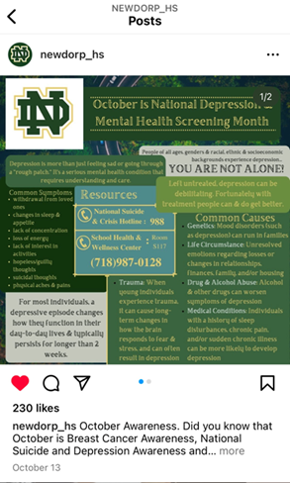
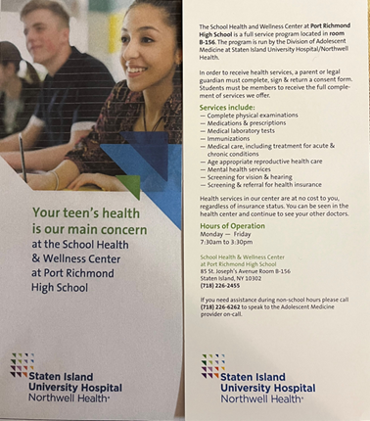
results
Activity | # in Attendance
Freshman Orientation Events | 1400
ELL Parents | 25
Asylum Families | 20
School Wellness Council | 9
Classroom Presentations | 570
Mental Health Scavenger Hunt | 20
Social Media | 4000+ (382 likes)

Slide 16

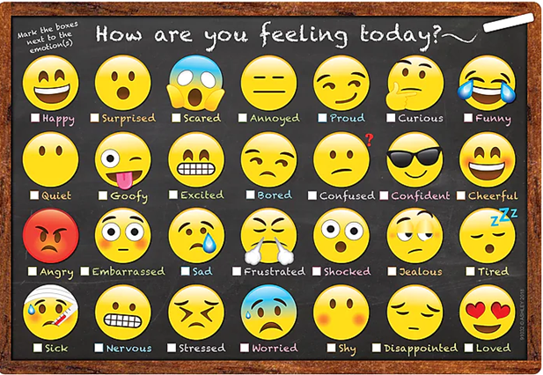
results
BH Screening Tool | # Completed | Scores
PHQ2 | 493 | 6 positive; 487 negative
PHQ9 | 94 | 8 severe; 16 moderately severe; 18 moderate; 25 mild; 20 minimal; 7 negative
GAD | 126 | 6 severe; 13 moderate; 17 mild; 23 minimal; 67 negative
# Students Identified | # Students Referred
155 | 112 (83 on-site/29 off-site)
BH Screening Tool | Jul-Dec 2021 | Jan-Jun 2022 | Jul-Nov 2022
PHQ2/9 total | 366 | 294 | 587
PHQ2/9 monthly | 61 | 49 | 117
# Positive screening | 89 (24%) | 70 (24%) | 93 (16%)
#Severe Depression | 7 | 8 | 8

Slide 17

MAIN OUTCOMES/ lessons learned
Main Outcomes
BH screenings increased (73/month to 117/month)
Lessons Learned
Increased comfort/ familiarity using screening tools (PHQ2/9, CRAFFT and GAD)
Effective utilization of social media for outreach purposes
Utilization of therapeutic intervention materials to enhance behavioral health therapy
Of the 155 students identified with BH issues, 112 (72%) were referred and agreed to continued behavioral health services (83 on-site & 29 off-site)
Total # of BH screenings increased, # of severely depressed unchanged
Numerous outreach activities were conducted

Slide 18

Shedding Your COVID-19
Harmony Healthcare Long Island SBHCs
Suanne Kowal-Connelly, MD, FAAP

Slide 19
our project & its Goals were shaped by the impact of the pandemic
3 Overarching Aims
3 SBHCs in 3 Nassau County marginalized, underserved and vulnerable communities
#1 Improve unhealthy weight and obesity related risk factors for SBHC high school students who have been particularly impacted by the COVID-19 pandemic.
#2 Improve unhealthy lifestyle habits, including but not limited to eating
behaviors and physical activity levels
#3 Improve mental health and a positive attitude/outlook
​​

Slide 20
Project Structure
16-week multidisciplinary program that comprehensively addresses unhealthy weight and unhealthy lifestyles

Slide 21
Pre and Post Testing - Medical
Weight
Blood pressure
Resting Heart Rate (reflects fitness level)
Hemoglobin A1C (Screening for Type 2 Diabetes - T2D)
Fasting Lipids
Fasting Glucose (Screening for T2D)
SGOT & SGPT (Screening for Non-Alcoholic Fatty Liver Disease – NAFLD)

Slide 22
Pre and Post Testing - Behavioral
  PHQ-9 (depression)
  GAD-7 (anxiety)
  EDE-QS (eating disorders and disordered eating)
  Healthy Habits Questionnaire (American Academy of Pediatrics)
  Self-Esteem Questionnaire

Slide 23
Coached and Structured Exercise Plans
Track workouts 3 days per week – lead by the NP staff at each site
Strength and conditioning workouts 2 days per week - to be done at home

Slide 24
Behavioral & Nutritional
Education and Support Group Sessions
  8 group sessions for each – alternating over the 16 weeks

Slide 25
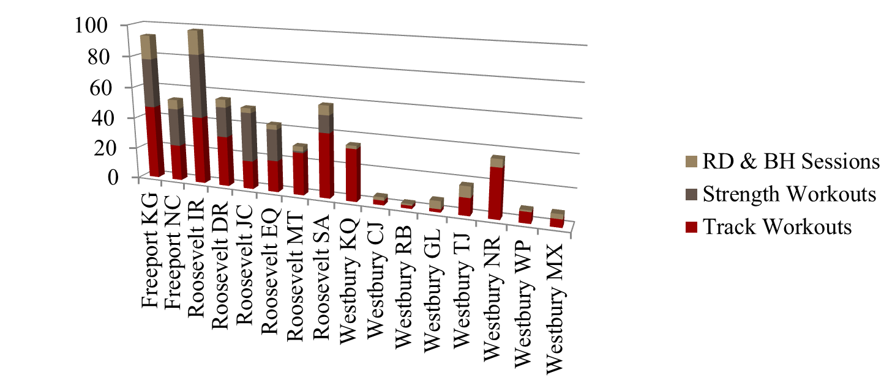
PERFORMANCE data - Cohort 1
Highest engaged students had the most success
  Student Success Details
  Freeport Student KG - Weight loss, Resting HR, PHQ-9, GAD-7, EDE-QS
  Roosevelt Student IR - Weight loss, PHQ-9, GAD-7, EDE-QS
  Roosevelt Student DR - FBG, GAD- 7
  Roosevelt Student JC - Weight loss, GAD-7, EDE-QS
  Roosevelt Student SA - Weight loss

Slide 26
SUMMARY
Those who put in the best effort had the greatest success.
Higher Engagement = More Positive Results

Slide 27
Addressing program Barriers
We would like to increase the number of students recruited
  Students cannot attend regularly after school
    Jobs
    Sports teams
    Parents do not want children staying after school
Improving consistent participation in all aspects of the program
Improving parental involvement

Slide 28

Next Steps
Implement the program into the regular school curriculum.
2 of our 3 school districts are actively engaged to make this a reality.
Improve parental involvement by creating a live-streaming program for families to participate in together.
Renaming of the Program - Program H.E.A.L.T.H.
  (Helping Educate And Lead the Transformation of Health)

Slide 29
Supporting School-Based Mental Health Providers in Adapting EMDR for a Diverse Pediatric Population
Donya V. Rhett, Ph.D.
March 2023
NewYork-Presbyterian School-Based Health Center Program

Slide 30
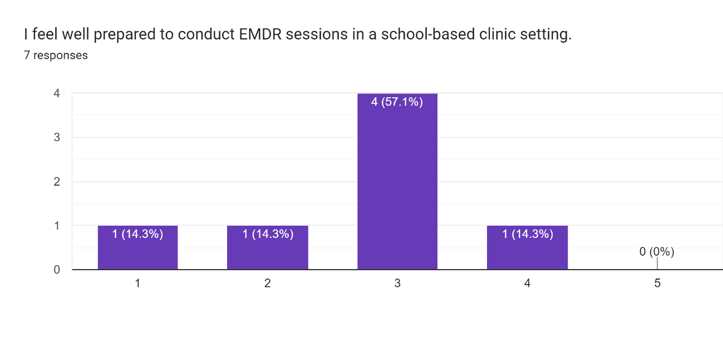
Who we serve & our original vision
Moment of clarity & refocus
Project team: Donya Rhett, PhD, Kelly Kirby, LCSW-R & Julie Blitzer, PhD
Seven SBHC’s-Harlem, Washington Heights, Inwood, the Bronx
Children grades pre-k-12
Multi-racial, multi-ethnic, multi-lingual, broad SES spectrum
Elevated rates of complex trauma
Exacerbation of trauma symptoms during pandemic
Serendipitous timing!
Implement widespread screening for trauma exposure and psychological sequelae
Expand offering of EMDR as a gold standard EBI
Staff not offering EMDR post-training at anticipated rates
Recognition of unique needs of our pediatric population & cultural considerations
Pause and assess team needs

Slide 31

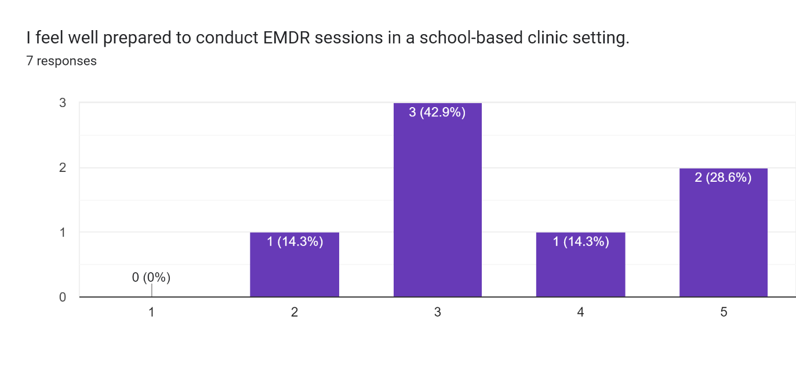


Goals, Accomplishments, Lessons Learned
Revised goals
Hire a culturally informed, child-focused EMDR consultant to conduct 8 group consultation sessions
Increase self-reported perception of readiness to conduct EMDR in SBHC settings
Increase rates of EMDR implementation across SBHC sites
Accomplishments at the halfway point
Contracted with Aileen Haddad-Perez, LCSW
5 consultation sessions
Increased sense of competency
Purchased developmentally appropriate materials & readings
Modest increase in implementation
Lessons Learned
  The importance of “checking the temperature”
  The value of in the room clinical experience and feedback
  The importance of post-training consultation support for complex EBI

Slide 32

DISCUSION

Slide 33

Scott Bloom, Subject Matter Expert
  Sbloomlcsw@gmail.com
Lisa Perry, Program Manager
  lisa.perry@morningsidehealthstrategies.com

