Slide 1
Katy Cook – Telehealth Project Manager, Adirondack Health Institute Lisa Perry – Principal, Morningside Health Strategies
Let’s Talk About Workflow!
Optimizing Provider and Student Experience in Virtual Care
Notes:
Ronda

Slide 2
Housekeeping
You will be muted upon entry.
Please keep your video off to maintain a strong connection.
To avoid audio issues, please choose either computer audio OR phone audio; using both may result in an echo on the line.
For optimal viewing, we recommend using Side-by-Side Mode. To activate Side-by-Side, click on View Options at the top center of your screen and choose Side-by-Side Mode from the dropdown.
Use chat freely to submit all questions and comments and we will answer as many questions as possible at the end of the presentation.
Notes:
Sarah

Slide 3
Todays Speakers
Katy Cook is the Telehealth Project Manager for Adirondack Health Institute. Since joining the organization in 2016, she has managed the end-to-end development of multiple telehealth programs and service lines in health centers, hospitals, behavioral health organizations, home health agencies, and more around the North Country region.
Lisa Perry is a consultant with extensive executive experience in health care performance improvement. As Principal at Morningside Health Strategies since 2019, her work has focused on data- and technology-driven innovation in patient care and operations. Prior to this, Lisa served as Sr. Vice President, Quality & Technology at the Community Health Care Association of New York State (CHCANYS).
Notes:
Sarah

Slide 4
Topics Discussed Today
Review of the Project
Why are Workflows Important in Health Care?
How to Build a Telehealth Workflow & Examples
How Your Telehealth Software Can Optimize Your Workflow
Experiences from other School-Based Health Centers
Q & A
Notes:
Katy

Slide 5
Introduction to the Project
In early 2021, the New York State School-Based Health Association was awarded a grant from the Mother Cabrini Health Foundation to increase & improve the use of telehealth in school-based health centers around the state.
Multiple health systems were contacted and surveyed, with 10 health systems signing onto the project, which will run through the end of 2021.
Notes:
Katy

Slide 6
Project Components
Up to 10 hours of individualized technical assistance to each sponsoring organization (SO).
Kickoff stipend to fund improvement efforts.
3 didactic webinars, with peer sharing.
Additional peer sharing via remote and/or face-to-face meetings.
Sessions at NYSBHA Annual Conference.
Reporting on quantifiable outcomes.
NYSBHF has applied for funds to continue & expand the project in 2021.
10 additional Sponsoring Organizations
Ongoing support of initial 10 Sponsoring Organizations
Notes:
Lisa

Slide 7
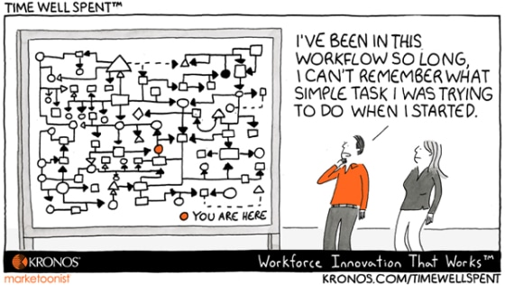
What Is A Workflow?
The Agency for Healthcare Research and Quality defines a workflow as:
“Workflow is the sequence of physical and mental tasks performed by various people within and between work environments. It can occur at several levels (one person, between people, across organizations) and can occur sequentially or simultaneously.”
Notes:
Katy
A workflow is a visual display of the progression of steps or tasks that make up a work process. These can be physical and/or mental tasks, performed by various people over a defined amount of time across different roles, teams, or locations. A workflow map shows a picture of who does what, and in which order.
You might hear workflows referred to as flowcharts, activity diagrams, cross-functional diagrams, process maps, swimlanes, or decision trees.

Slide 8
Why Are Workflows Important in Health Care?
Health care workflow management to fine-tune facility workflows is essential for removing redundancies that unnecessarily eat up resources, delay the provision of medical care, and slow patient throughput.
Effective workflow management can streamline workflows and has been shown to reduce the potential for medical errors, help to ensure compliance with industry regulations such as HIPAA, and improve the quality of care provided to patients.
Notes:
Katy
Workflows also provide an opportunity for improvement – what are you trying to accomplish, how will you know that a change is an improvement, and what changes can you make that will result in improvement?
Consider your current performance and determine your goals and identify key measures. Workflows are a visual display for current performance and where improvements can be made.

Slide 9
Building a Telehealth Workflow
The American Medical Association suggests that practices explore how to incorporate telehealth with the least amount of workflow disruption, when introducing the new offering.
Logistics may have to be altered to integrate telehealth, such as
physical workspace arrangement (including equipment quantity & location),
appointment scheduling procedure,
staff time, and
communication
Notes:
Katy
Consider how to incorporate telehealth appointments with the least amount of workflow disruption, especially at first, to help seamlessly introduce the technology to your practice. Seek to understand the preferences and needs of both patients and clinicians, such as the times of day that may work best for them and what types of barriers they may have to engaging in a telehealth visit, to ensure your workflow accounts for these details. Your telehealth workflow will vary depending on your organization, type, size, and structure.
LP: I added the italics because I thought this was a very interesting point for them to keep in mind while creating the telehealth workflow.
Under daily logistics, I added (including equipment quantity & location)”, and I changed the formatting a bit. I always like to bullet lists to make it very clear.

Slide 10
Building a Telehealth Workflow
Basic Steps
Identify and name the process.
Clarify the purpose or outcome of the process.
Identify a clear start and end point for the process.
List or draw out the tasks and decision points within the process and put them in order.
Define and note which role completes each step.
Notes:
Katy
Grab the subject matter experts involved in the telehealth program – use pencil and Post-it notes to start. Ask questions such as “walk me through a typical day” or “who does this step?” or “who makes that decision?”
Map the current state first, and then the future state. Shorter is better.

Slide 11
Building a Telehealth Workflow
Tips and Considerations for Telehealth Workflows:
Write down or draw the existing clinical and administrative workflow - where can you make some adjustments to integrate telehealth services seamlessly?
Update necessary procedures & task assignment, such as appointment scheduling and instructions, patient training, consent, platform assistance, and billing.
Document all workflow changes and create resources to share with all practice staff.
Utilize your electronic health record (EHR) system for seamless recording of all pertinent patient information, and include these steps in your workflow.
Notes:
Katy
“Write down or draw” to the first bullet because I think if they don’t already have this, it is essential for thinking through and documenting changes. I have observed that different people within the same unit have different perceptions of the model workflow they are supposed to be following. It is important to have consensus on what exists before trying to change it.
- added “task assignment” to the second bullet as there will be important changes here. Something previously done by a provider may now be done by an MA, or vice versa.
- added “and include these steps in your workflow” to the last bullet.
A clear workflow is vital to ensure everyone understands their role and how to maximize the value of telehealth through procedures that:
• Set clear patient and provider expectations
• Ensure telehealth is used for clinically relevant purposes and adheres to licensure, policy, and reimbursement requirements
• Streamline the patient experience
• Preserve the patient-clinician relationship

Slide 12
Benefits of Mapping Workflows
Defines the tasks in a process and the order in which they occur.
Establishes who does what within a process, reducing confusion.
Provides a clear, concise visual document to use as a means of communicating about a process & training new staff.
Helps to identify gaps or problem areas within a process, enabling teams to direct improvement efforts.
Notes:
Katy

Slide 13
Key Considerations When Designing a Telehealth Workflow
How will the telehealth technology integrate with the EHR?
How will clinicians document telehealth visits?
How will telehealth visits fit into the clinician's schedule?
Where will telehealth visits take place?
How will patients hear about telehealth, and learn more about it?
How will patients register for a telehealth appointment?
Which staff will be involved with scheduling telehealth appointments and coordinating with distant/hub site staff? How will referrals be managed?
Who will obtain informed consent?
On the day of the appointment, who will explain the process to the patient & ensure the patient is on the line before the provider joins?
Who is responsible for coordinating follow-up care?
Notes:
Katy
Implementing a new telehealth program or service line is the perfect time to map a new workflow.

Slide 14
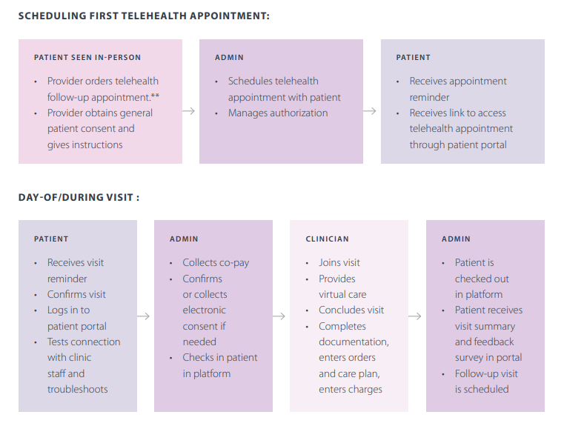
Example Telehealth Workflow
Source: https://www.ama-assn.org/system/files/2020-04/ama-telehealth-playbook.pdf
Notes:
LP: I’d almost be inclined to show this workflow first as it is most typical of a primary care visit. It seems a good way to ease into the topic. Then I’d show the workflow for office closed/office open. Last, I show the 2 slides for the specialty consult.
If your organization first launched telehealth in response to COVID-19, you may have created a rushed, bare-bones program to meet short-term needs. However, to maintain a successful telehealth program in a post-COVID world, you need a robust plan for your telehealth workflow. The minute details of your telehealth workflow should be adapted to your telehealth platform and the unique needs of your agency and clients.
Katy to pause and ask the group a question around their own experiences with building a workflow.

Slide 15
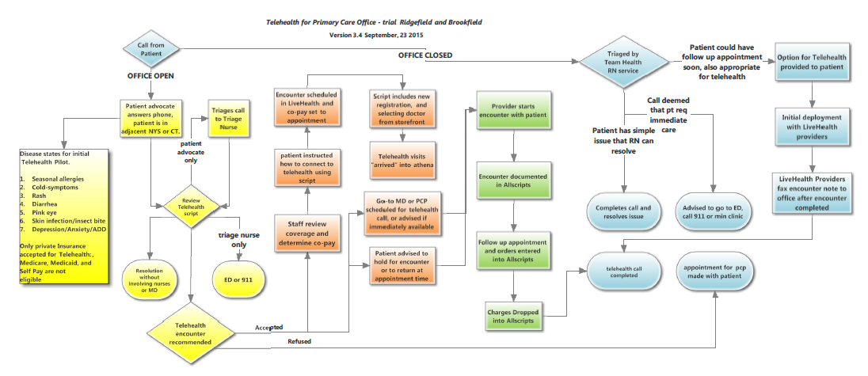
Example Telehealth Workflow
Notes:
Katy
LP: What’s interesting about this workflow is it distinguishes between workflow when office is open vs closed, includes at least 3 types of software (LiveHealth [on-demand doctor visits, 24/7), athena and Allscripts!) and uses color for the stages:
yellow is triage and decision whether to use telehealth
Orange is pre-call prep once telehealth is chosen
Green is the call & documentation
Blue is everything that happens when office is closed

Slide 16
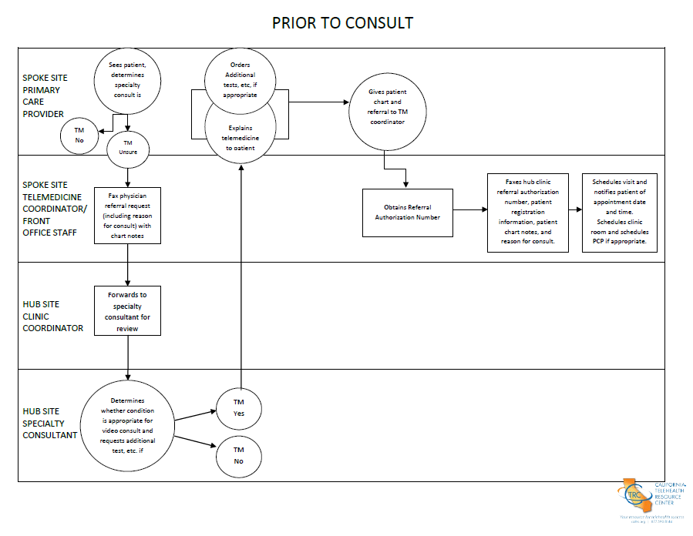
Example Telehealth Workflow
Source: https://www.caltrc.org/?s=workflow
Notes:
Katy – will speak to the terms hub and spoke and clarify that these mean patient/student and provider.
LP: Given the notes you have for the next slide, it seems you plan to spend more time on this workflow than the others. I think that is a good idea as we won’t have enough time to dwell on all the workflows. From what I can see this is a workflow to determine if a telehealth specialty consult by provider at hub site is appropriate, and if it is to discuss logistics with patient & schedule visit. What is interesting is that in the Day of Consult workflow, the patient goes to the Spoke Site where the connection to the specialty provider at the Hub Site is made. It’s a hybrid type of call, which I’m sure is common for specialty care.

Slide 17
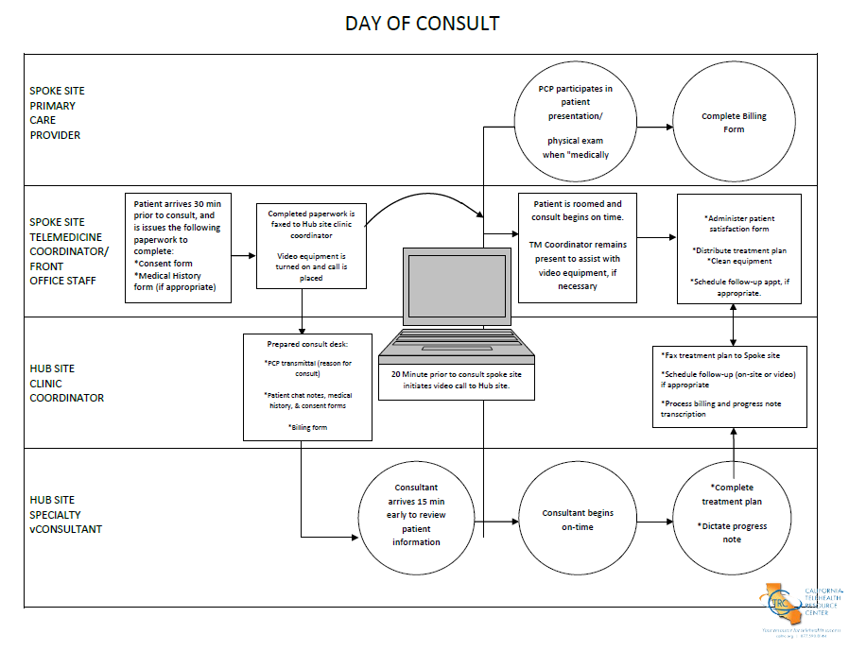
Example Telehealth Workflow
Source: https://www.caltrc.org/?s=workflow
Notes:
DAY OF CONSULT
Telemedicine Coordinator gives their front desk receptionist the appropriate questionnaire packet to hand out when patient arrives (this may also be mailed to the patient prior to appointment). Patient should arrive 30 minutes prior to appointment if filling out a questionnaire is required.
a. Patient must sign consent form (once per year).
b. Patient must complete medical history form if not already done.
2. Telemedicine Coordinator will prepare exam room and turn on telemedicine unit 30 minutes (or as early as possible) prior to the consultation. If peripheral equipment (derm camera, nasopharyngoscope, stethoscope, etc.) will be used during consult, please turn on and test image/sound prior to consult.
3. Fax completed history, and consent form, and any additional last minute test results to the Specialty site Telemedicine Coordinator.
a. The specialist requires the completed history and questionnaire prior to the beginning of the consult.
4. Ask the specialist if he/she has received all the necessary information before rooming the patient.
5. Once the patient and the primary care provider are in the room , the site coordinator remains in the room to assist with the equipment as necessary.
LP: I think it would be good to highlight that everything is completely set up and ready to go by the time the specialist enters the visit.
AFTER THE VISIT - on the day of consult
1. At this time, the specialist may wish to send (via fax, or other electronic format) written instructions for the patient. Any written Instructions from the Specialist are to be copied and distributed. You may wish to ask the patient to move to the waiting room while waiting for the information.
• Patient
• Primary care provider
• Patient medical record
2. Clean equipment if used (any cameras or scopes that have touched the patient).
3. If another patient is scheduled immediately following the previous appointment, ask the specialist "Are you ready for me to room the next patient?" before proceeding.
AFTER THE VISIT
1. Telemedicine Coordinator receives the specialist's signed dictation, and places it in the referring provider's box for review prior to filing in the patient's medical record.
2. Telemedicine Coordinator reviews the consult dictation from the specialist. If a follow up appointment as well as any further tests are required , work with the primary care provider and the patient to complete the required tests, fax the results to the specialty site, and schedule a follow up appointment.

Slide 18
Peer Experiences in Telehealth Workflow
Urban Health Plan
Dr. Jennifer Genuardi
Director of Clinical Best Practices & Education
Notes:
Lisa to introduce Dr. Genuardi

Slide 19
The Unexpected Positives of Telehealth
More intimate, less artificial.
Increased access to hard-to-reach, high-risk patients.
Enhanced team-based care.
Notes:
Please provide examples of each

Slide 20
Workflow for Outreach & Scheduling
Patient request or SBHC staff outreach.
Scheduling: Flow or pull.
Call reminders or if they miss, the provider calls them.
Notes:
Please provide examples of each

Slide 21
Workflow Models of Provider - MA Teaming
Screening & prep by Medical Assistant (MA), trouble-shooting technology issues – by phone or video.
If MA & provider are working in synch, patient can be kept in a “waiting room” with MA until the provider joins.
If MA & provider are not in perfect synch, patient is told approximate wait time and receives a text with link to join when provider is ready.
After provider visit is complete, provider can message MA to rejoin and hear discharge plan OR to follow-up on discharge plan in eCW.

Slide 22
How Software Can Help Optimize Workflow
Ease of adding translator or other party – the + icon.
Ease of messaging MA during provider visit.
Integration to EHR – initially unidirectional, now bidirectional.
Notes:
Please edit/add however you like

Slide 23
How Software Can Hinder Workflow
Lack of “dialer” within software led to use of personal phones.
Resolution: Vendor developed dialer functionality.
“Dialer”, when implemented, was blocked or patients would not pick up because call was not identified as Urban Health or Dr. Genuardi.
Resolution: Ability to identify caller was added (3 words allowed).

Slide 24
How Software Can Hinder Workflow
Translator cannot assist with technology issues – can only join call after connection is established.
Resolution: Bilingual MAs assist.
EHR telehealth software works only on web-based version.
Resolution: Acquired external vendor software.

Slide 25
Happy to Help…Feel free to reach out
Jennifer.Genuardi@urbanhealthplan.org

Slide 26
How Your Telehealth Software Platform Can Help with Workflow
Telehealth platforms will help the SBHC staff rapidly catch the reason for the call or appointment for each student. They will prioritize care delivery and recognize additional information sources.
The right telehealth software platform will give SBHC staff the opportunity to use their resources better to serve more students and provide the highest quality treatment. Consider some vendor recommendations to refine the telehealth workflow to render the possible use of telehealth technology.
With telehealth technology, digital visits can be almost as effective, if not more than an in-person visit. The more telehealth software systems integrate to your Practice & EHR systems, the less stress on staff to manage patient flow and patient information.
Why not, for example, integrate your SBHC management solutions with your telemedicine solutions? Submit automatic appointment updates based on a clinical calendar, make a virtual visit, and bill for a session, all from one location.
Notes:
Katy
Specifically, some Telehealth platforms use powerful monitoring strategies to monitor patient flow, reduce waiting times, and enhance overall workflow through real-time data collection and reporting.

Slide 27
Telehealth Software Platform Examples
Notes:
Katy
Some key aspects of telehealth software platforms to consider when building a workflow or streamlining an existing one:
Does the platform allow for integration with your EMR platform? Does your EMR platform offer an integrated telehealth offering? Epic & Medent are two examples of EMRs that offer this.
Does the platform offer simple user management and single sign-ons for less tech-savvy patients and providers?
Does the platform offer a secure patient waiting room until the provider signs on?
Does the platform offer a video remote interpretations service quickly?
Does the platform allow for screen or document sharing, making notations visible to all attendees?
Does the platform allow for device integration, such as a high-quality video camera with far-end camera control?

Slide 28
Next Steps
Once the workflow is established, now what?
Designate someone who can champion continuous review of the workflow.
Set a schedule to review and update workflows.
Make sure that the workflow is accessible to all staff and in a central location, either in a shared drive or team binder.
Determine a communication strategy for updating staff when a workflow changes.
Notes:
Katy

Slide 29
Future Webinars
Thursday, July 29th from 3:30-4:30pm: Telehealth Technology Post-COVID: It’s More Than Just a Smartphone.
Notes:
Lisa

Slide 30
Additional Resources
Agency for Healthcare Research and Quality Workflow Assessment for Health IT Toolkit
American Medical Association Telehealth Implementation Playbook
California Telehealth Resource Center Workflow Results
National TRC Webinar – Mapping and Designing Telehealth Clinic Workflows
Notes:
Katy

Slide 31
Questions?
Thanks for listening!
kcook@ahihealth.org | 518-480-0111 x.315
Lisa.perry@morningsidehealthstrategies.com | 914-263-6745
Notes:
Katy
Thank you for joining us today – we will now take time to answer some questions!

