Slide 1
Data is Power: Making the Case for NY SBHCs
Carlos Romero
Jamie Duvall
November 10, 2021

Slide 2
Agenda
Past, present, and future of the Data Hub Project
Data Hub participation to date
State level data from project participants
Comparison data from project participants by sponsor and SBHC
Data Snapshots
New York State reporting
What’s next?

Slide 3
New York SBHC Data Hub
Project Objectives:
  Demonstrate the value of a statewide evaluation and data system; and
  Develop a plan to scale and sustain the evaluation and data system statewide.
Conference
Presentation
Needs
Assessment
Evaluability
Study
Two-Year
Pilot
2007
2014
2017
2018
2019
2020
2021
New Mexico
Colorado
Notes:
Value – efficiency, more data, more confidence in data, more utility
Share history of work with NY SBHCs, and CLARIFY intention is to keep it going beyond current funding (through November 2021).
Briefly state the objectives.

Slide 4
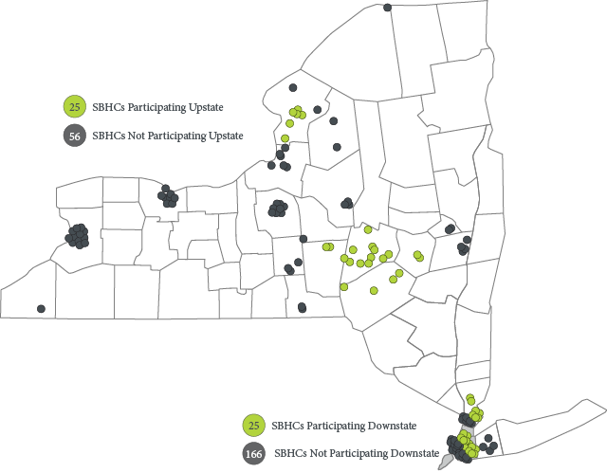
New York Data Hub – Pilot Year 1
5
Sponsor
Organizations
50
SBHCs

Slide 5

New York Data Hub – Pilot Year 2
Recruit more upstate SBHCs
9
Sponsor
Organizations
86
SBHCs

Slide 6
Data Hub Participants
Cohort 1 Sponsoring Organizations
Cohort 2 Sponsoring Organizations
Bassett Healthcare Network
North Country Family Health Center
Northwell Health
Open Door Family Medical Center
Urban Health
Community Healthcare Network
Institute for Family Health
Morris Heights Health Center (pending final approval)
Ryan Health

Slide 7
New York State Level Data
Data are from Cohort 1 of the Data Hub Project – July 1, 2020 - June 30, 2021
Data presented are preliminary and subject to change.
Notes:
A few clarification and caveats on quantity and quality of data. this is for cohort 1and throughout statewide is all the data we have for the cohorts – so still more for illustration than analysis. Not intended to be exhaustive – and we’re still building confidence in the data. So keep those things in mind as we look at data - we are still not ready to draw conclusions, but getting closer. At least we’re teasing you with your own real data now. Illustrating the levels of detail we can show

Slide 8






Visits and Patients
Data are from Cohort 1 of the Data Hub Project – July 1, 2020 - June 30, 2021
Average Number of Visits per
Patient by Type of Care
9,648
Patients
34,018 Visits
Behavioral Health
6.00
Primary Care
2.42
****These data counts are lower than normal due to COVID-19 and school closures****

Slide 9
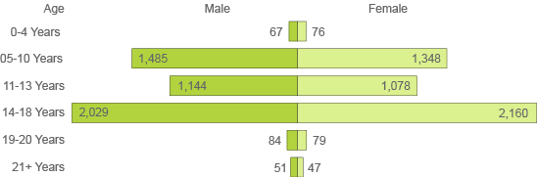
SBHC Patient Demographics
Data are from Cohort 1 of the Data Hub Project – July 1, 2020 - June 30, 2021
Gender by Age
65% of those who identified as White also identified as Hispanic.

Slide 10
State SBHC Visit Types
Data are from Cohort 1 of the Data Hub Project – July 1, 2020 - June 30, 2021
Sports Physical
Sexual Health
Comprehensive Well Exam
13%
PC & BH
Acute Care
Breakdown of PC
13% of patients came to the SBHCs for both a PC & BH visit

Slide 11
NY SBHCs Meet Diverse Needs by Patient Age
Data are from Cohort 1 of the Data Hub Project – July 1, 2020 - June 30, 2021
Visit patterns differed across age groups, including frequency and type of visits. These differences highlight the breadth and depth of services provided at SBHCs and illustrate the important role SBHCs play within the broader health care system.
Primary Care
Behavioral Health

Slide 12
New York State Comparison Data
Data are from Cohort 1 of the Data Hub Project
Data presented are preliminary and subject to change.

Slide 13
SBHC Performance Measures
Comprehensive Well Exam
Annual comprehensive exam for patients aged 0 to <21
Body Mass Index (BMI)
BMI assessment completed for patients aged 3 to 17
Depression Screening
Depression screening for patients aged 11 to <21

Slide 14
State Level Performance Measures by Patient
Percentage of SBHC patient’s who received the type of service.
Data are from Cohort 1 of the Data Hub Project – July 1, 2020 - June 30, 2021
Notes:
Add date and cohort range
What is the performance measure for each?

Slide 15
Comprehensive Well Exam by Sponsor
Percentage of SBHC patient’s who received the type of service.
Data are from Cohort 1 of the Data Hub Project – July 1, 2020 - June 30, 2021
State Average 74%
Notes:
What is state PM?

Slide 16
Comprehensive Well Exam by Sponsor & SBHC
Percentage of SBHC patient’s who received the type of service.
Data are from Cohort 1 of the Data Hub Project – July 1, 2020 - June 30, 2021
State Average 74%
Sponsor 5
Sponsor 2
Sponsor 1
Sponsor 4
Sponsor 3
Notes:
Add date and cohort range
Add state PM?

Slide 17
BMI Assessment by Sponsor
Percentage of SBHC patient’s who received the type of service.
Data are from Cohort 1 of the Data Hub Project – July 1, 2020 - June 30, 2021
State Average 76%
Notes:
Add date and cohort range
PM?

Slide 18
BMI Assessment by Sponsor & SBHC
Percentage of SBHC patient’s who received the type of service.
Data are from Cohort 1 of the Data Hub Project – July 1, 2020 - June 30, 2021
State Average 76%
Sponsor 5
Sponsor 2
Sponsor 1
Sponsor 4
Sponsor 3
Notes:
Add date and cohort range

Slide 19
Depression Screening by Sponsor
Percentage of SBHC patient’s who received the type of service.
Data are from Cohort 1 of the Data Hub Project – July 1, 2020 - June 30, 2021
State Average 70%
Notes:
Add date and cohort range
State PM?

Slide 20
Depression Screening by Sponsor & SBHC
Percentage of SBHC patient’s who received the type of service.
Data are from Cohort 1 of the Data Hub Project – July 1, 2020 - June 30, 2021
State Average 70%
Sponsor 5
Sponsor 2
Sponsor 1
Sponsor 4
Sponsor 3
Notes:
Add date and cohort range
State PM?

Slide 21

Improving the Data
One of the nice things about Apex is the data validation piece. And it really takes a lot off my plate as the Director of the program.

Slide 22
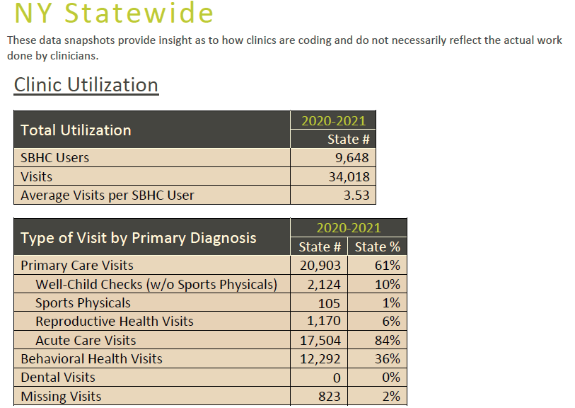
Data Snapshot - Utilization

Slide 23
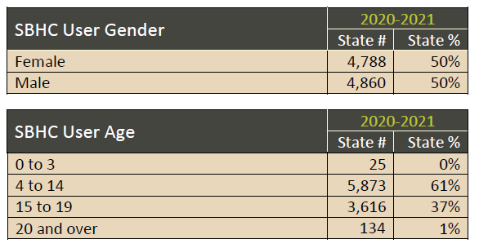
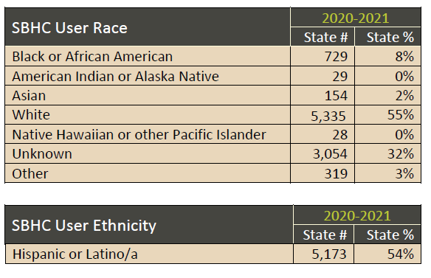
Data Snapshot - Demographics

Slide 24
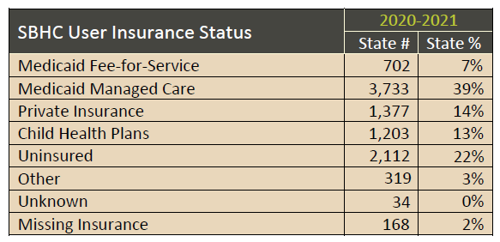
Data Snapshot – Insurance Type

Slide 25
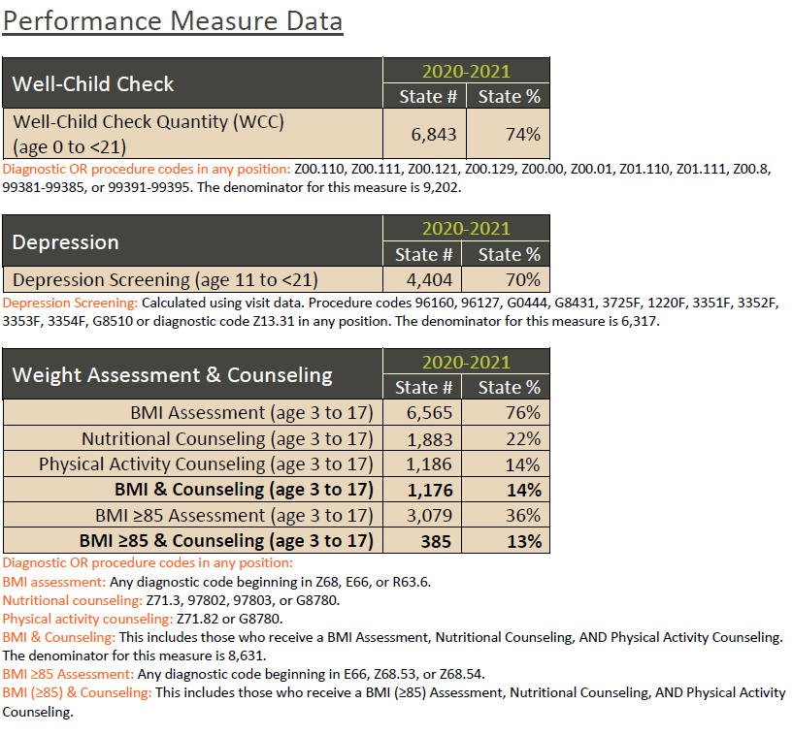
Data Snapshot – Performance Measures

Slide 26
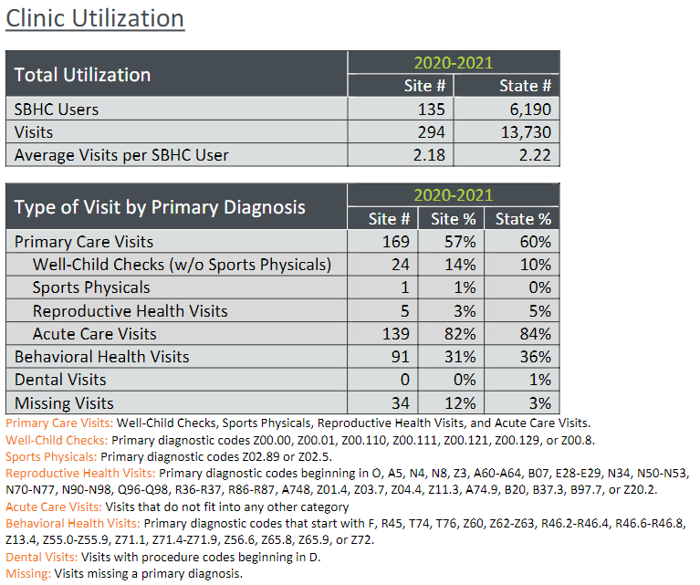
Data Snapshot – SBHC vs State
Compare SBHC to State

Slide 27
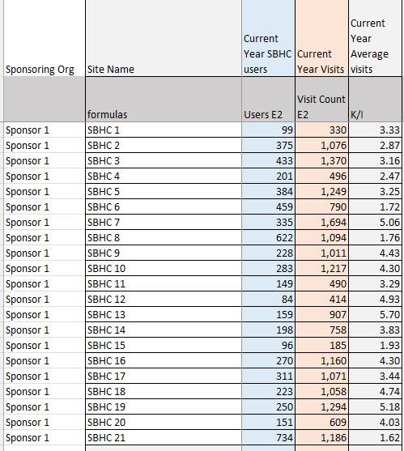
Table-based Reports for Quick Comparison
Notes:
Some transition to table passed reports. Can we add another example from data snapshot?

Slide 28
New York Data Hub – Future Comparisons
Upstate vs Downstate
Urban vs Rural
Small, Medium, and Large SBHCs

Slide 29

Reporting
New York Data Hub – We can help!

Slide 30
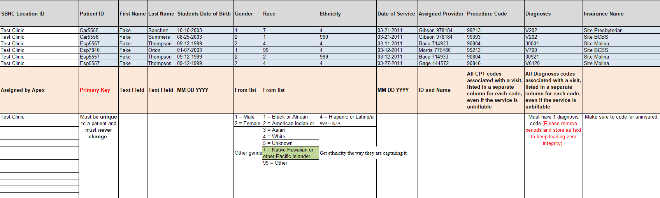
Data Export – Granular data needed to produce data shown today

Slide 31
Notes:
Transition/explanation. I want to pause here and draw out some distinctions around the different parts of the data hub. The four uses cases: gathering existing data, collecting new data, linking data, and reporting. We’ve been focusing on EHR data – data that exist in digital form. But the other use case of the data hub is collecting new data - data that are not in digital form. One example of that is what we call the operational plan.
Refer to use cases: existing data

Slide 32
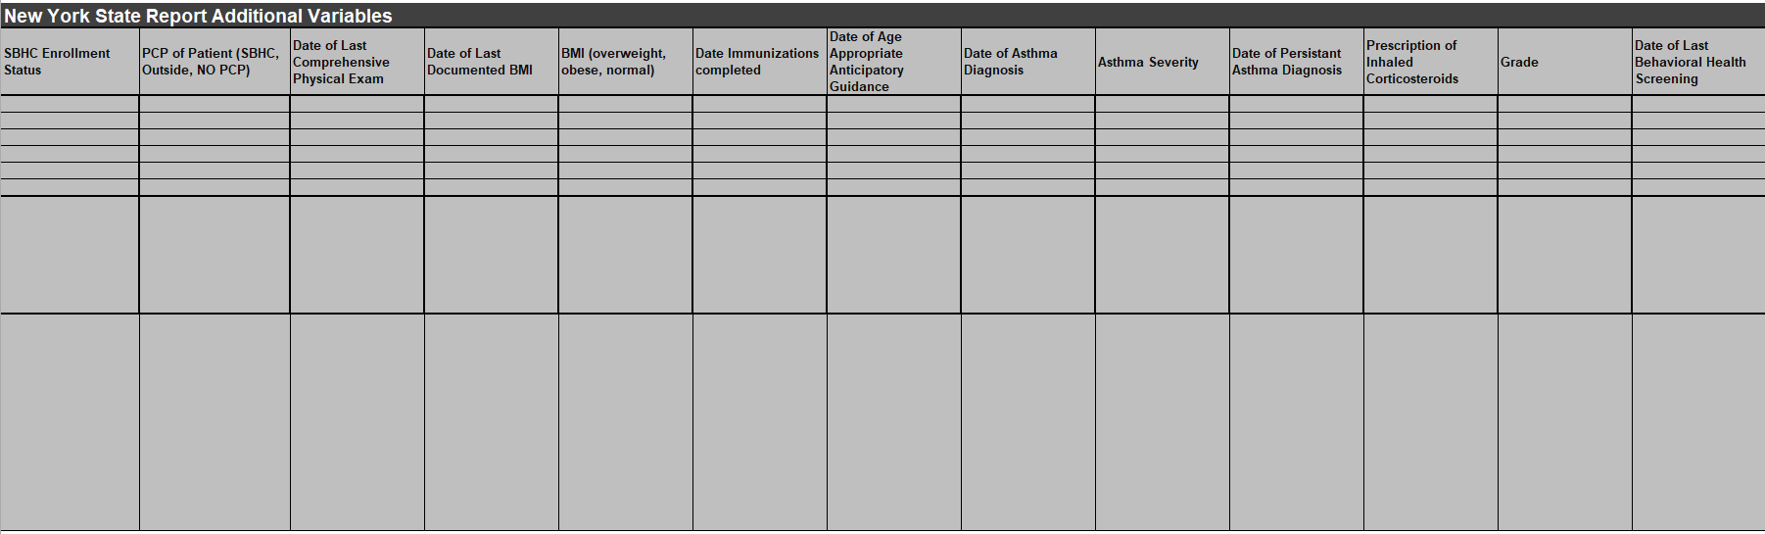
Data Export – Fields needed to produce NYS reports
Notes:
Another is this appended data export to collect other data elements needed for state reporting. This can adapt to any changes in state reporting and – perhaps – we might have some influence on what data are most needed and most available and achieve even more efficiency.

Slide 33
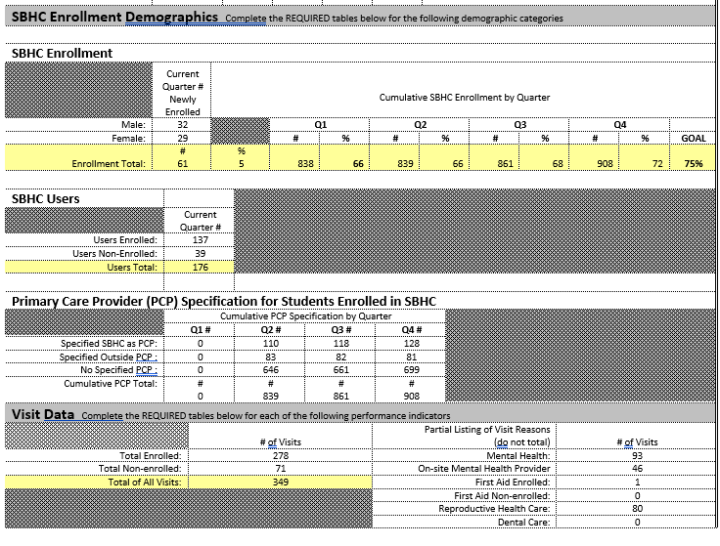
NYS Quarter 4 Report - Utilization

Slide 34
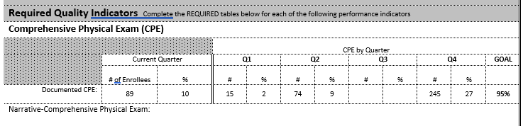
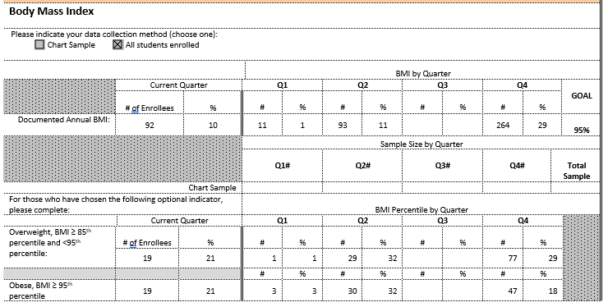
NYS Quarter 4 Report – Quality Indicators
Notes:
Draw attention here

Slide 35
Testimonials from the Field
The last two reporting periods Apex has put everything together for us. I’ve looked it over and been able to provide that information to the state. Something that used to take me weeks, hours, months, I think, to get correct data.
Once we tweaked out the pieces - and it wasn’t really that complicated…once we sort of tweaked that out, we got the third quarter reports done for us by Apex. We have an internal way of doing it, but these guys did it so much faster.

Slide 36
What’s next….

Slide 37
Revisiting Objectives
Project Objectives:
  Demonstrate the value of a statewide evaluation and data system; and
  Develop a plan to scale and sustain the evaluation and data system statewide.
What are the benefits of participating?
  Collect data once, use it often
    Reduced burden for data collection and reporting
    Improved data integrity
    Increased value of the data
What is the cost to my organization?
  Alliance can support costs associated with setting up EHR export.
  Additional costs include staff time
    Set up data extraction, BAA
    Regular data check-ins, updates to Operational Plan reports
Consider the ROI: Save you time & money!
  Evaluability study estimated approximately 40 hours per year per site on data collection and reporting
  More time to focus on care at individual and population levels

Slide 38

Business Associates Agreement
(BAA)
EHR visit data extraction (IT)
Data Reports
Data Calls
Operational Data
(Clinical/
Administrative)

Slide 39




Questions & Discussion

